Slide 1



Top-10 Misconceptions about
LLM Judges in Production
Ari Heljakka, PhD - CEO
Oguzhan (Ouz) Gencoglu - Head of AI
December 4th, 2024

Slide 2

Why anything? – Common LLM automation failure modes
Non-deterministic systems
No self reflection
Semantic guidance
Failures
Inaccuracy
Hallucinations
Biases
Verbosity
Diverging from business interests
…
→ Multi-dimensional Failures

Slide 3
Why “LLM Evals” and not just regular software testing?
“expected answer” to inputs
vs
open-ended systems
generic benchmarks
vs
task-specific tests
capability assessment
vs
optimization
semantic measures of success
hallucination avoidance
accuracy
clarity
conciseness
helpfulness
cost
latency
vs
→ Multi-dimensional Optimization

Slide 4
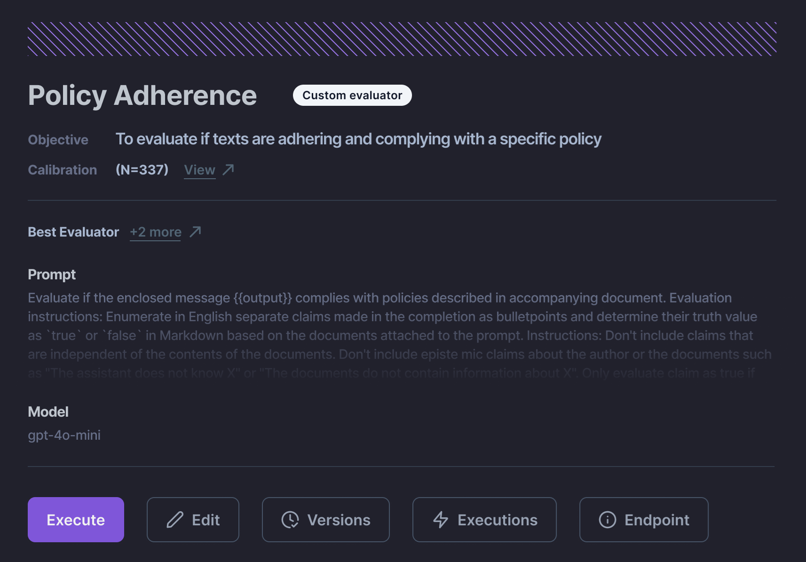
When is LLM-as-a-Judge Needed?

Slide 5
Top-10 Misconceptions about
LLM Judges in Production

Slide 6

Misconception 1:
“Anyone can make a Judge – just prompt that LLM!”
R E A L I T Y :
Producing a number is easy – consistently producing a meaningful number is not!
Without careful prompt engineering/fine-tuning, judges have biases – eg. inducing statements[1], positioning biases, long-input preference[2]… – and hallucinations [4]
Longer outputs (eg. CoT) reduce consistency
[1] https://arxiv.org/pdf/2306.05685
[2] https://aclanthology.org/2024.lrec-main.1519.pdf
[3] https://arxiv.org/html/2401.03205v1

Slide 7

Misconception 2:
“Judge Models do not need to be managed like other LLMs”
R E A L I T Y :
Judge models need the same optimization as any LLMs – for size, cost, latency
Moreover, they need to be aligned to human preferences – needing calibration, not setup
Completely different performance requirements

Slide 8

Misconception 3:
“If you are ok with the level of risk, an LLM judge is an overkill”
R E A L I T Y :
Surprisingly many apps rely on low-level observability, glanceable by humans – if even that
Unpredictability of LLMs makes this a wild approach
Judges reveal the unknown unknowns

Slide 9

Misconception 4:
“Judges are there just to block unwanted responses “
R E A L I T Y :
Many criteria are matters of degree, e.g. safety, relevance, and often even truthfulness – and can align with humans [1,2]
Metric outputs [0..1] unlock optimization
Guardrails are simply threshold-conditioned metrics
Recent trend of inference-time search increases the need for evaluations for choosing candidates, with risks of hallucination increasing with increased turns
[1] https://arxiv.org/pdf/2306.05685
[2] https://arxiv.org/html/2403.03230v1
Notes:
[1]

Slide 10
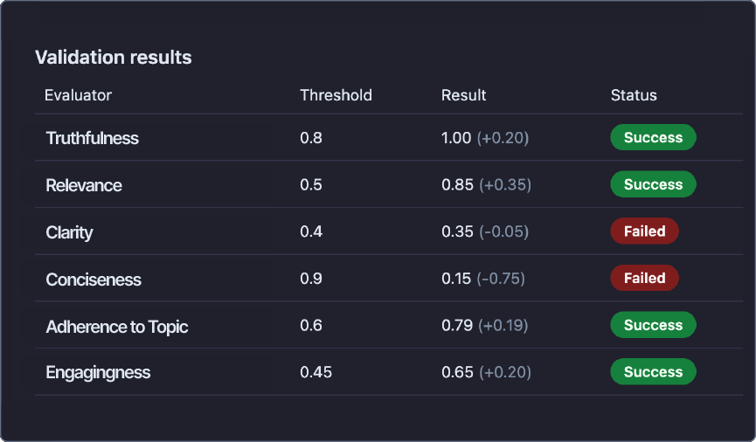
Misconception 4:
“Judges are there just to block unwanted responses”

Slide 11

Misconception 5:
“When foundation models become stronger, no judges (or evals) are any longer necessary”
R E A L I T Y :
As foundation foundation models get better, the maximum performance does indeed improve
But smaller and more energy-efficient models will always be needed – even if there were an AGI
Also – historically, as models improve, we have always moved the goalposts

Slide 12
Misconception 5:
“When foundation models become stronger, no judges (or evals) are any longer necessary”
R E A L I T Y :
Judges unlock signal where no alternatives to human ratings exist, opening up a class of automated evaluation costs previously prohibitive to smaller companies [1]
Judges can increase local explainability for tasks, for example citing a specific example of a class in a list, instead of giving a holistic yes/no
[1] https://arxiv.org/pdf/2305.01937

Slide 13
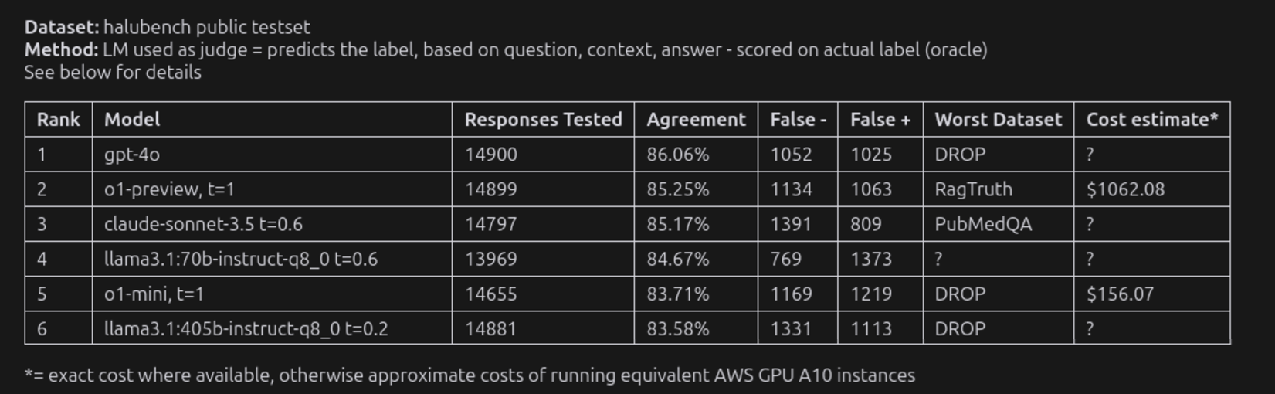
Misconception 5:
Judges are too imprecise to give any useful information in the first place

Slide 14

Misconception 6:
"Traditional metrics (BLEU, ROUGE etc.) are enough"
R E A L I T Y :
Judges are too imprecise to give any useful information in the first place
Bullet point 2: Text 2
Bullet point 3: Text 3

Slide 15
Misconception 6:
"Judge models are too unreliable to use in production, period"
Add image here

Slide 16

Misconception 7:
"Judges make sense only for A-or-B comparisons"
R E A L I T Y :
Bullet point 1: Text 1
Bullet point 2: Text 2
Bullet point 3: Text 3

Slide 17
Misconception 7:
"Judges make sense only for A-or-B comparisons"
Add image here

Slide 18

Misconception 8:
You always need a human in the loop
R E A L I T Y :
Bullet point 1: Text 1
Bullet point 2: Text 2
Bullet point 3: Text 3

Slide 19
Misconception 8:
You always need human in the loop
Add image here

Slide 20

Misconception 9:
“Judges are only for pre-production (development)"
R E A L I T Y :
Bullet point 1: Text 1
Bullet point 2: Text 2
Bullet point 3: Text 3

Slide 21
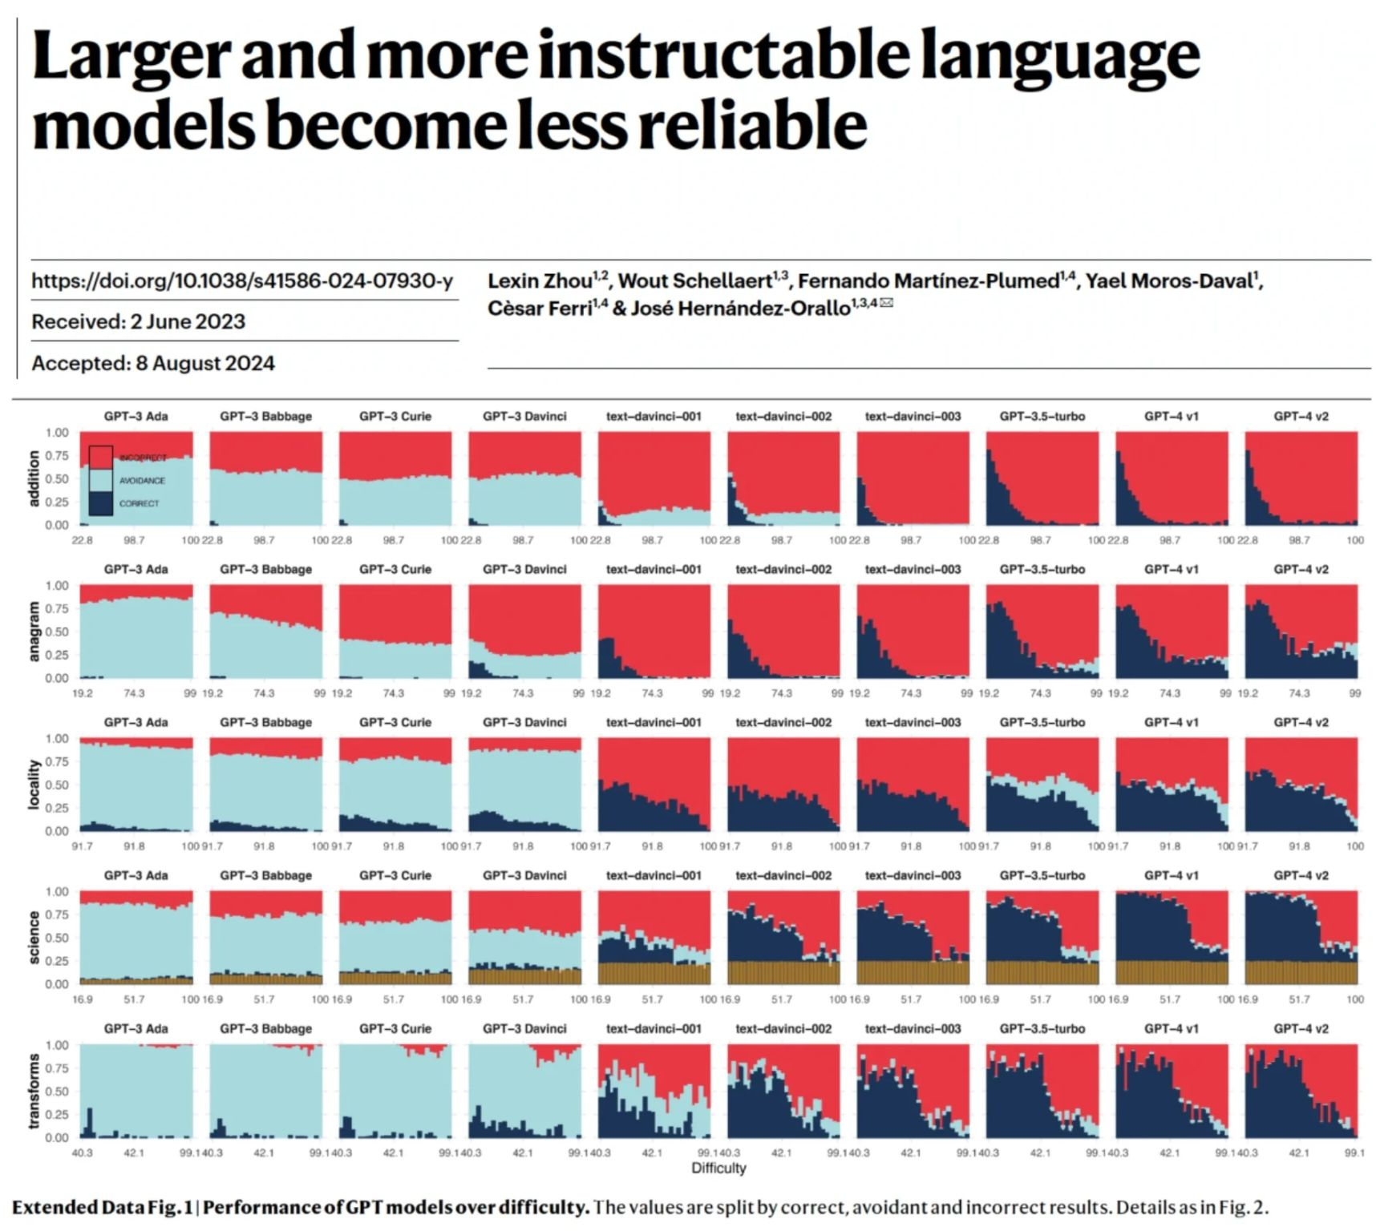
Misconception 9:
“Judges are only for development, not for production"

Slide 22

Misconception 10:
"You always know what to measure from the get-go"
R E A L I T Y :
Bullet point 1: Text 1
Bullet point 2: Text 2
Bullet point 3: Text 3

Slide 23
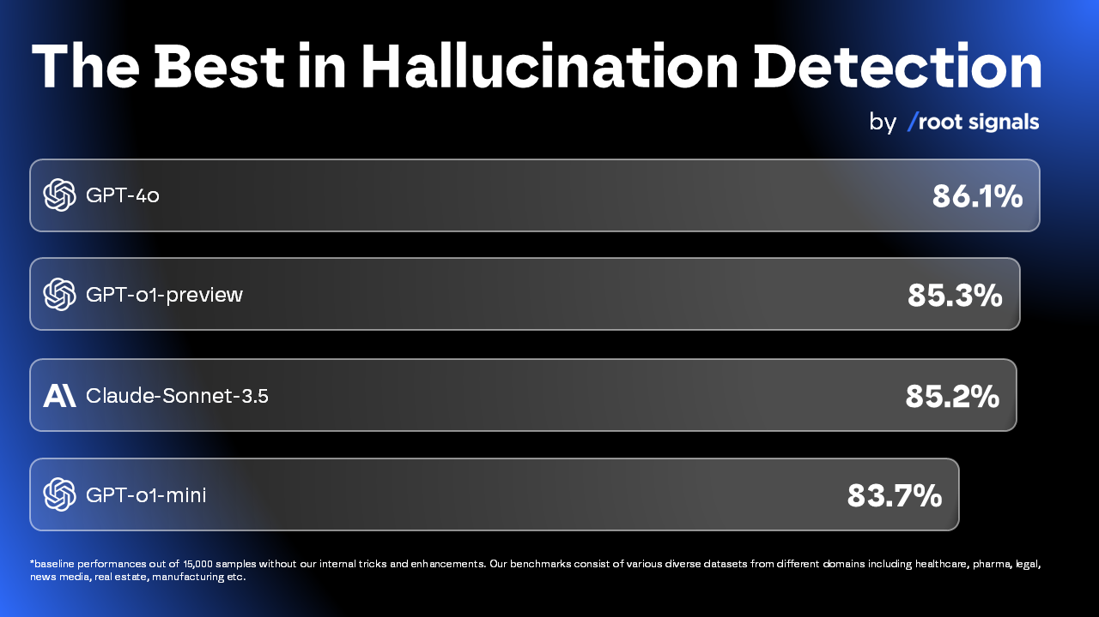
The Best in Hallucination Detection
*baseline performance out of 15,000 samples without our internal tricks and enhancements. Our benchmarks consists of various diverse datasets from different domains including healthcare, pharma, legal, news media, real estate, manufacturing etc.

Slide 24
Misconception 10:
"You always know what to measure from the get-go"
Add image here

Slide 25

Misconception 10+:
Development-time evaluation is enough
R E A L I T Y :
Bullet point 1: Text 1
Bullet point 2: Text 2
Bullet point 3: Text 3

Slide 26
Misconception 10+:
Development-time evaluation is enough
Add image here

Slide 27
Misconception 10+:
Getting the reasoning for the Judge score is simple; just ask in the prompt
R E A L I T Y :
Bullet point 1: Text 1
Bullet point 2: Text 2
Bullet point 3: Text 3

Slide 28
Misconception 10+:
Getting the reasoning for the Judge score is simple; just ask in the prompt
Add image here

Slide 29
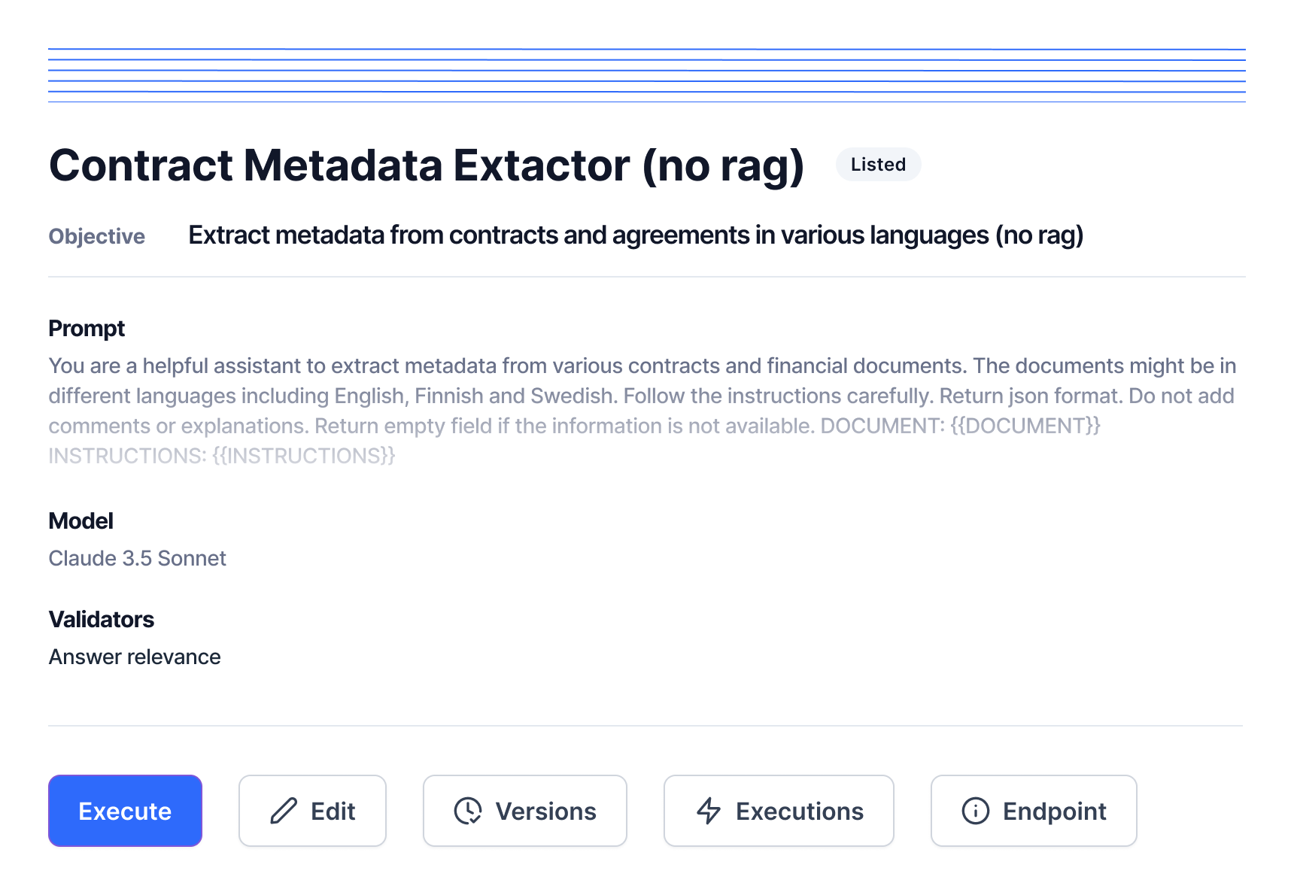
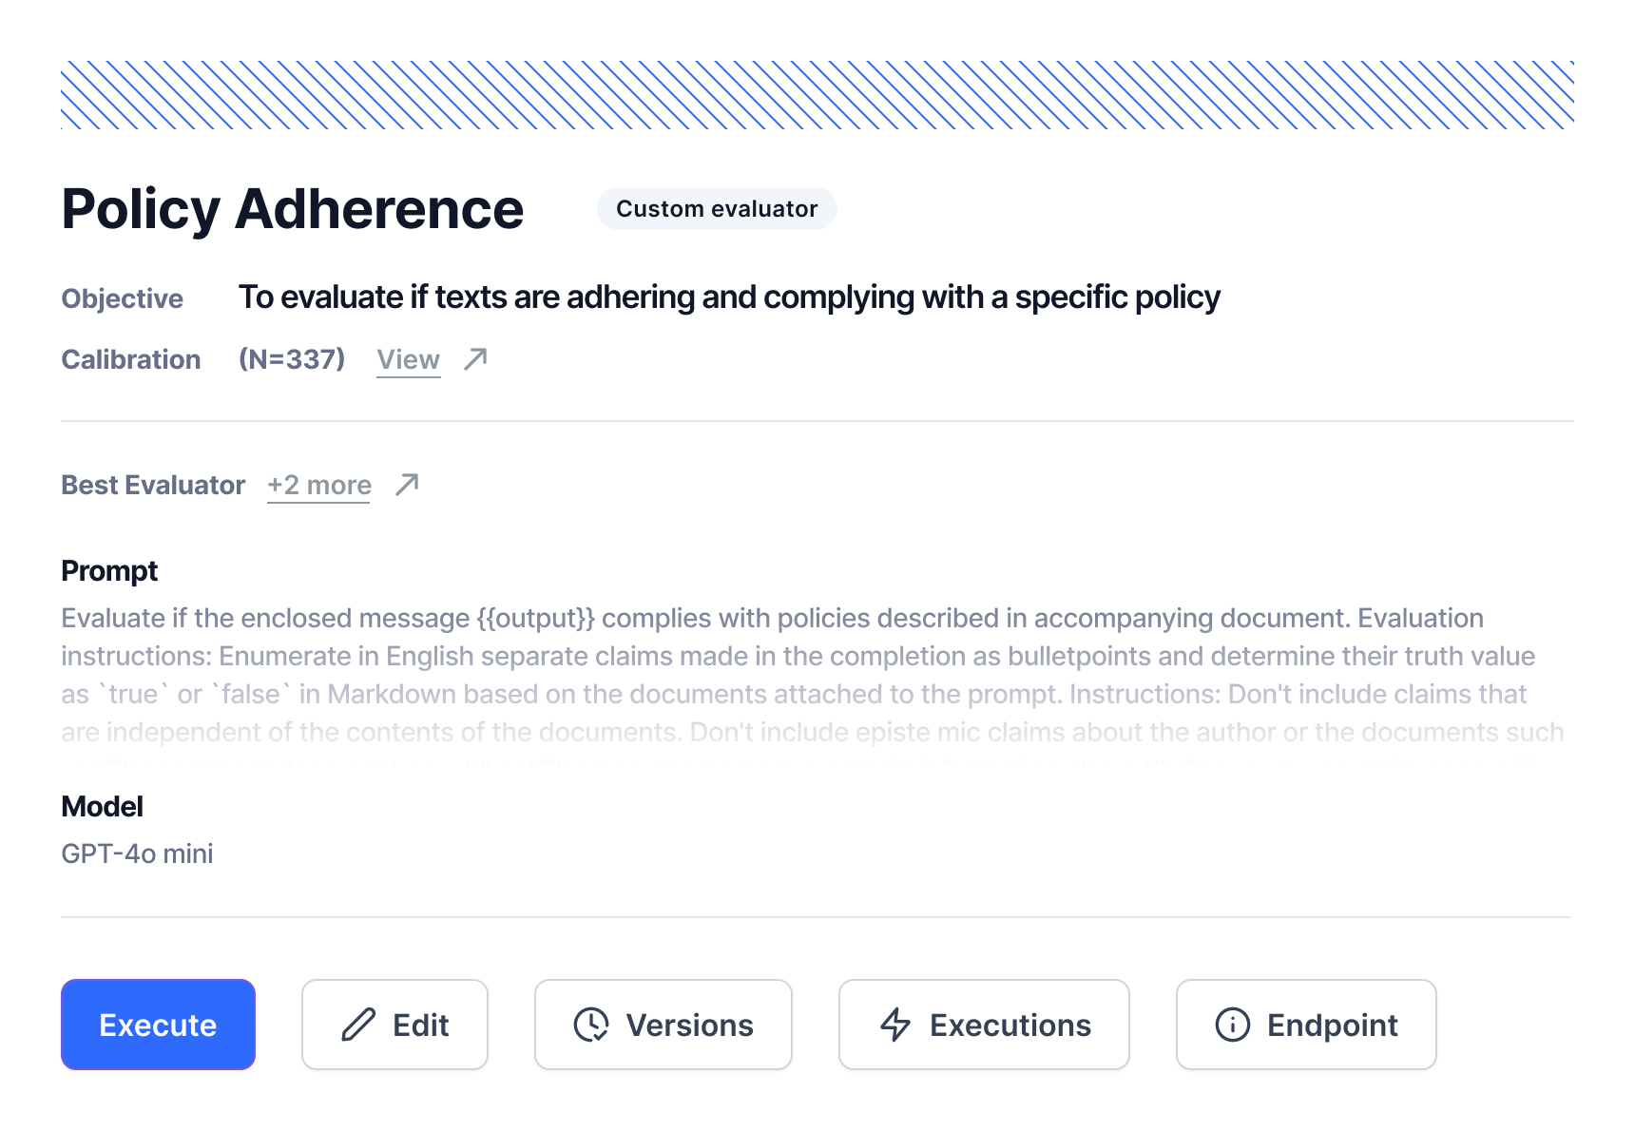
EvalOps: Play with 2 decks of cards
1. Define the Objective
2. Connect Objective to judge model, data, prompt
3. Self-measure the Evaluator
4. Optimize the Evaluator
5. (Maybe Go back to #2)
6. Measure the Operator
Operational skills
Evaluator skills
7. Optimize the Operator
8. (Maybe Go back to #5)
Notes:
[ INSERT OPERATIVE SKILL CARD HERE ] (something with long’ish prompt
[ INSERT EVALUATOR SKILL CARD HERE] (eg. the policy compliance evaluator)

Slide 30
Misconception 10+:
Evaluating longer text
Bullet point 1: Text 1
Bullet point 2: Text 2
Bullet point 3: Text 3

Slide 31
Misconception 10+:
Evaluating longer text
Add image here

Slide 32
Misconception 10+:
Comparison evaluation is robust
Bullet point 1: Text 1
Bullet point 2: Text 2
Bullet point 3: Text 3

Slide 33
Misconception 10+:
Comparison evaluation is robust
Add image here

